Slide 1
Chapter 2
Instructions: Language of the Computer

Slide 2
ISA: A Thin Software/Hardware Interface
ISA as an abstraction
A model for machine-level programming
Abstracts the underlying implementation/technology
Application
Compiler
Operating
Software
Assembler
System
Instruction Set Architecture
Hardware
Processor
Memory
I/O System
Datapath & Control
Digital Design
Circuit Design
Transistors

Slide 3
Instruction Set
The repertoire of instructions of a computer
Different computers have different instruction sets
But with many aspects in common

Slide 4
Instruction Set Architectures
Early computers had very simple instruction sets
Simplified implementation
Later trend was to add more and more instructions to new CPUs to do elaborate operations
VAX architecture had an instruction to multiply polynomials!
RISC philosophy (Cocke IBM, Patterson, Hennessy, 1980s) – Reduced Instruction Set Computing
Keep the instruction set small and simple, makes it easier to build fast hardware.
Let software do complicated operations by composing simpler ones.

Slide 5
The MIPS Instruction Set
Used as the example throughout the book
Stanford MIPS commercialized by MIPS Technologies (www.mips.com)
Large share of embedded core market
Applications in consumer electronics, network/storage equipment, cameras, printers, …
Typical of many modern ISAs
See MIPS Reference Data tear-out card, and Appendixes B & E
Why MIPS instead of Intel x86?
MIPS is simple, elegant. Don’t want to get bogged down in gritty details.
MIPS widely used in embedded apps, x86 little used in embedded, and more embedded computers than PCs

Slide 6
MIPS (RISC) Design Principles
Simplicity favors regularity
Fixed size instructions: 32 bits
Small number of instruction formats
Opcode always the first 6 bits
Smaller is faster
Small instruction set
Limited number of registers
Few addressing modes
Make the common case fast
Arithmetic/logic operands in registers
Immediate operands (16 bits)
Good design demands good compromises
Three instruction formats
Fields are aligned as much as possible

Slide 7
Arithmetic Operations
Add and subtract, three operands
Two sources and one destination
add a, b, c # a gets b + c
All arithmetic operations have this form
Design Principle 1: Simplicity favours regularity
Regularity makes implementation simpler
Simplicity enables higher performance at lower cost

Slide 8
Arithmetic Example
C code:
f = (g + h) - (i + j);
Compiled MIPS code:
add t0, g, h # temp t0 = g + h add t1, i, j # temp t1 = i + j sub f, t0, t1 # f = t0 - t1

Slide 9
Simplicity and Regularity
In MIPS ISA:
All Instructions have the same length: 32 bits
Limited number of instruction formats: 3
Instruction fields (opcode, operands) are aligned among the different formats
Arithmetic/logic instructions have 3 operands
Each operand is 32 bits wide
By comparison, in x86 ISA:
Instruction length varies from 1 to 17 bytes
Many instruction formats
Only two operands
One of the operands serves also as destination

Slide 10
Assembly Variables: Registers
Unlike HLL like C or Java, assembly cannot use variables
Why not? Keep Hardware Simple
Assembly Operands are registers
Limited number of special locations built directly into the hardware
Operations can only be performed on these!
Benefit: Since registers are directly in hardware, they are very fast (faster than 1 ns - light travels 30cm in 1 ns!!! )

Slide 11
Registers
Register: a small container of data in the CPU
Not part of memory
Has very fast access (much faster than memory)
Capacity (width) is small: fixed number of bits
MIPS has 32 general purpose registers
Why 32? Smaller is faster, but too small is bad. Goldilocks problem.
Drawback: Since registers are in hardware, there are a predetermined number of them.
Solution: MIPS code must be very carefully put together to efficiently use registers
Registers are numbered 0 to 31
Each register has width 32 bits (called a “word”)
Many instructions use only register operands (→speed!)
Registers are divided into groups
Each group has a specific role (or usage) by convention
Registers have symbolic names that reflect their role
Roles are exploited by compilers to allocate data to registers

Slide 12
Names of MIPS Registers
Each register can be referred to by number or name
Number references:
$0, $1, $2, … $30, $31
But also
$16 - $23➔ $s0 - $s7 (correspond to C variables)
$8 - $15 ➔ $t0 - $t7 (correspond to temporary variables)
More registers to come…
In general, use names to make your code more readable

Slide 13
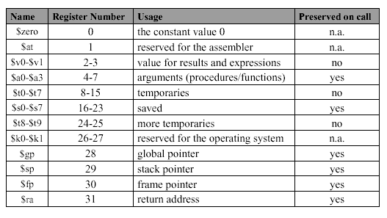
MIPS General Purpose Registers

Slide 14
C, Java variables vs. registers
In C (and most High Level Languages) variables declared first and given a type
Example: int fahr, celsius; char a, b, c, d, e;
Each variable can ONLY represent a value of the type it was declared as (cannot mix and match int and char variables).
In Assembly Language, registers have no type; operation determines how register contents are treated

Slide 15
Using Data in Registers
Arithmetic/logic operations work only on registers (never on values in memory)
One of the operands must be a register
The other operand can be a register or a constant
The result is always placed in register
There are “only” 32 registers
What if there is more data than free registers?
Some registers can be spilled (copied) to memory

Slide 16
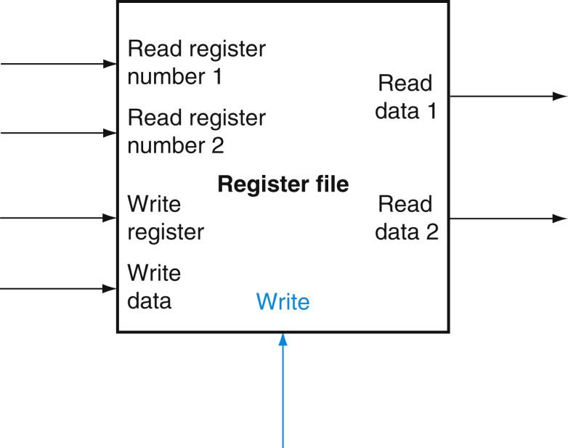
MIPS Register File
Holds 32 registers, each 32-bits wide
Two read ports and one write port
Designed for fast 3-operand arithmetic on registers
reg3 = reg1 op reg2
Reads two registers and writes one register in a single cycle
Read data is available during entire cycle
Write is clocked at the end of the cycle
➔ One register can be both read and then written in same cycle
5
32
5
5
32
32
Clock

Slide 17
Big Idea: Stored-Program Computer
Instructions are represented as bit patterns - can think of these as numbers.
Therefore, entire programs can be stored in memory to be read or written just like data.
Can reprogram quickly (seconds), don’t have to rewire computer (days)
Known as the “von Neumann” computers after widely distributed tech report on EDVAC project
First Draft of a Report on the EDVAC
^{by}
^{John von Neumann}
^{Contract No. W–670–ORD–4926}
^{Between the}
United States Army Ordnance Department and the
^{University of Pennsylvania}
Moore School of Electrical Engineering
^{University of Pennsylvania}
^{June 30, 1945}

Slide 18
Consequence #1: Everything Addressed
Since all instructions and data are stored in memory, everything has a memory address: instructions, data words
both branches and jumps use these
C pointers are just memory addresses: they can point to anything in memory
Unconstrained use of addresses can lead to nasty bugs; up to you in C; limited in Java by language design
One register keeps address of instruction being executed: “Program Counter” (PC)
Basically a pointer to memory: Intel calls it Instruction Pointer (a better name)

Slide 19
Consequence #2: Binary Compatibility
Programs are distributed in binary form
Programs bound to specific instruction set
Different version for Macintoshes and PCs
New machines want to run old programs (“binaries”) as well as programs compiled to new instructions
Leads to “backward-compatible” instruction set evolving over time
Selection of Intel 8086 in 1981 for 1st IBM PC is major reason latest PCs still use 80x86 instruction set (Pentium 4); could still run program from 1981 PC today

Slide 20
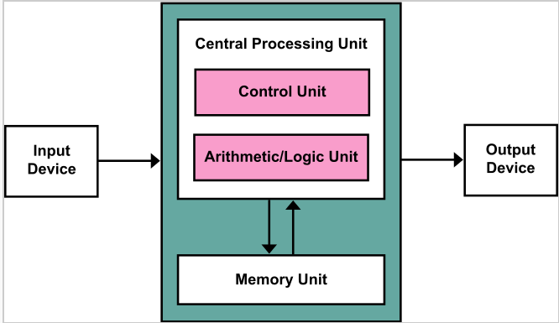
Von Neumann architecture scheme

Slide 21
Register Operands
Arithmetic instructions use register operands
MIPS has a 32 × 32-bit register file
Use for frequently accessed data
Numbered 0 to 31
32-bit data called a “word”
Design Principle 2: Smaller is faster
c.f. main memory: millions of locations

Slide 22
Addition and Subtraction of Integers
Addition in Assembly
Example: add $s0,$s1,$s2 (in MIPS)
Equivalent to: a = b + c (in C)
where C variables ⇔ MIPS registers are:
a ⇔ $s0, b ⇔ $s1, c ⇔ $s2
Subtraction in Assembly
Example: sub $s3,$s4,$s5 (in MIPS)
Equivalent to: d = e - f (in C)
where C variables ⇔ MIPS registers are: d ⇔ $s3, e ⇔ $s4, f ⇔ $s5

Slide 23
Addition and Subtraction of Integers Example 1
How to do the following C statement?
a = b + c + d - e;
Break into multiple instructions
add $t0, $s1, $s2 # temp = b + c
add $t0, $t0, $s3 # temp = temp + d
sub $s0, $t0, $s4 # a = temp - e
A single line of C may break up into several lines of MIPS.
Notice the use of temporary registers – don’t want to modify the variable registers $s
Everything after the hash mark on each line is ignored (comments)

Slide 24
Memory Operands
Main memory used for composite data
Arrays, structures, dynamic data
To apply arithmetic operations
Load values from memory into registers
Store result from register to memory

Slide 25
Main Memory
Linear array of memory cells
Each cell has its own address
→Cell address is similar to array index
In MIPS, each cell is one byte wide (8 bits)
Byte is the smallest size accessible in memory
0
8 bits of data
1
8 bits of data
2
8 bits of data
3
8 bits of data
4
8 bits of data
5
8 bits of data
6
8 bits of data
...

Slide 26
Memory Addresses
A “word” is 4 consecutive bytes starting at an address that is a multiple of 4 (word-aligned)
The address of a word points to the byte with lowest address
Maximum memory size in MIPS
2³² bytes = 4GBytes = 2³⁰ words
Memory addresses are really in bytes, not words
Addr of lowest byte in word is addr of word
…
…
…
…
…
3
12
13
14
15
2
8
9
10
11
1
4
5
6
7
0
0
1
2
3

Slide 27
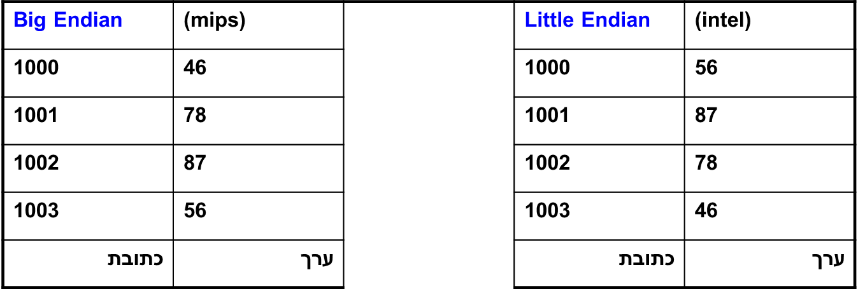
Order of Bytes in a Word Value
A word-size value in memory can be kept in two ways
Little Endian: lowest address contains least significant byte
Big Endian: lowest address contains most significant byte
For example: integer value 0x46788756 stored at address 1000 in memory
MIPS implementation can be Little or Big Endian
MARS Simulator uses Little Endian
Address
Content
Address
Content

Slide 28
Memory Operand Example 1
C code:
g = h + A[8];
g in $s1, h in $s2, base address of A in $s3
Compiled MIPS code:
Index 8 requires offset of 32
4 bytes per word
lw $t0, 32($s3) # load word add $s1, $s2, $t0
offset
base register

Slide 29
Memory Operand Example 2
C code:
A[12] = h + A[8];
h in $s2, base address of A in $s3
Compiled MIPS code:
Index 8 requires offset of 32
lw $t0, 32($s3) # load word add $t0, $s2, $t0 sw $t0, 48($s3) # store word
Offset must be a constant known at assembly time.
$s3 – base register (pointer)
32, 48 – offsets in bytes
$s3+32 and $s3+48 must be multiples of 4
offset
base register

Slide 30
Loading and Storing bytes
In addition to word data transfers (lw, sw), MIPS has byte data transfers:
load byte: lb
store byte: sb
Same format as lw, sw
E.g., lb $s0, 3($s1)
contents of memory location with address = sum of “3” + contents of register $s1 is copied to the low byte position of register $s0.
zzz zzzz
$s0:
xxxx xxxx xxxx xxxx xxxx xxxx
x
byte loaded
…is copied to “sign-extend”
This bit

Slide 31
Registers vs. Memory
Registers are faster to access than memory
Operating on memory data requires loads and stores
More instructions to be executed
Compiler must use registers for variables as much as possible
Only spill to memory for less frequently used variables
Register optimization is important!

Slide 32
Immediate Operands
Constant data specified in an instruction
addi $s3, $s3, 4
No subtract immediate instruction
Just use a negative constant
addi $s2, $s1, -1
Design Principle 3: Make the common case fast
Small constants are common
Immediate operand avoids a load instruction

Slide 33
The Constant Zero
MIPS register 0 ($zero) is the constant 0
Cannot be overwritten
Useful for common operations
E.g., move between registers
add $t2, $s1, $zero

Slide 34
Overflow in Arithmetic
Reminder: Overflow occurs when there is a “mistake” in arithmetic due to the limited precision in computers.
Example (4-bit unsigned numbers):
15 1111
+ 3 + 0011
18 10010
But we don’t have room for 5-bit solution, so the solution would be 0010, which is +2, and “wrong”.

Slide 35
Overflow handling in MIPS
Some languages detect overflow (Ada), some don’t (most C implementations)
MIPS solution is 2 kinds of arithmetic instructions:
These cause overflow to be detected
add (add)
add immediate (addi)
subtract (sub)
These do not cause overflow detection
add unsigned (addu)
add immediate unsigned (addiu)
subtract unsigned (subu)
Compiler selects appropriate arithmetic
MIPS C compilers produce addu, addiu, subu

Slide 36
Representing Instructions
Instructions are encoded in binary
Called machine code
MIPS instructions
Encoded as 32-bit instruction words
Small number of formats encoding operation code (opcode), register numbers, …
Regularity!
Register numbers
$t0 – $t7 are reg’s 8 – 15
$t8 – $t9 are reg’s 24 – 25
$s0 – $s7 are reg’s 16 – 23

Slide 37
Instructions as Numbers (1/2)
How do we represent instructions?
Remember: Computer only understands 1s and 0s, so “add $t0,$0,$0” is meaningless.
MIPS/RISC seeks simplicity: since data is in words, make instructions be fixed-size 32-bit words also.

Slide 38
Instructions as Numbers (2/2)
One word is 32 bits, so divide instruction word into “fields”.
Each field tells processor something about instruction.
We could define different fields for each instruction, but MIPS seeks simplicity, so define 3 basic types of instruction formats:
R-format
I-format
J-format

Slide 39
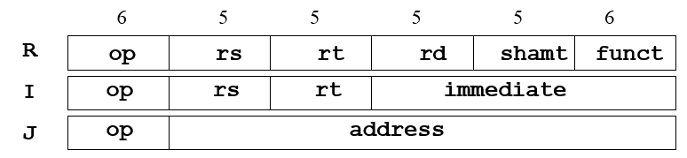
MIPS Instruction Formats
Formats are aligned as much as possible
Common field positions and semantics
op – opcode rs – 1st source register
funct – function-code rt – 2nd source register / target register
shamt – shift amount rd – destination register
immediate – 16-bit constant/offset
address – 26-bit “pseudo-direct” address
Design Principle 4: Good design demands good compromises
Different formats complicate decoding, but allow 32-bit instructions uniformly
Keep formats as similar as possible

Slide 40
R-Format Instructions (1/5)
Define “fields” of the following number of bits each: 6 + 5 + 5 + 5 + 5 + 6 = 32
For simplicity, each field has a name:
Important: On these slides and in book, each field is viewed as a 5- or 6-bit unsigned integer, not as part of a 32-bit integer.
Consequence: 5-bit fields can represent any number 0-31, while 6-bit fields can represent any number 0-63.
6
5
5
5
5
6
opcode
rs
rt
rd
shamt
funct

Slide 41
R-Format Instructions (2/5)
What do these field integer values tell us?
opcode: partially specifies what instruction it is
Note: This number is equal to 0 for all R-Format instructions.
funct: combined with opcode, this number exactly specifies the instruction
Question: Why aren’t opcode and funct a single 12-bit field?
We’ll answer this later.

Slide 42
R-Format Instructions (3/5)
More fields:
rs (Source Register): usually used to specify register containing first operand
rt (Target Register): usually used to specify register containing second operand (note that name is misleading)
rd (Destination Register): usually used to specify register which will receive result of computation

Slide 43
R-Format Instructions (4/5)
Notes about register fields:
Each register field is exactly 5 bits, which means that it can specify any unsigned integer in the range 0-31. Each of these fields specifies one of the 32 registers by number.
The word “usually” was used because there are exceptions that we’ll see later. E.g.,
mult and div have nothing important in the rd field since the dest registers are hi and lo
mfhi and mflo have nothing important in the rs and rt fields since the source is determined by the instruction (see COD)

Slide 44
R-Format Instructions (5/5)
Final field:
shamt: This field contains the amount a shift instruction will shift by. Shifting a 32-bit word by more than 31 is useless, so this field is only 5 bits (so it can represent the numbers 0-31).
This field is set to 0 in all but the shift instructions.
For a detailed description of field usage for each instruction, see green insert in COD

Slide 45
R-Format Example (1/2)
MIPS Instruction:
add $8,$9,$10
opcode = 0 (look up in table in book)
funct = 32 (look up in table in book)
rd = 8 (destination)
rs = 9 (first operand)
rt = 10 (second operand)
shamt = 0 (not a shift)

Slide 46
R-Format Example (2/2)
MIPS Instruction:
add $8,$9,$10
Decimal number per field representation:
Binary number per field representation:
hex representation: 012A 4020_{hex}
decimal representation: 19,546,144_{ten}
Called a Machine Language Instruction
0
9
10
8
0
32
000000
01001
01010
01000
00000
100000
_{hex}

Slide 47
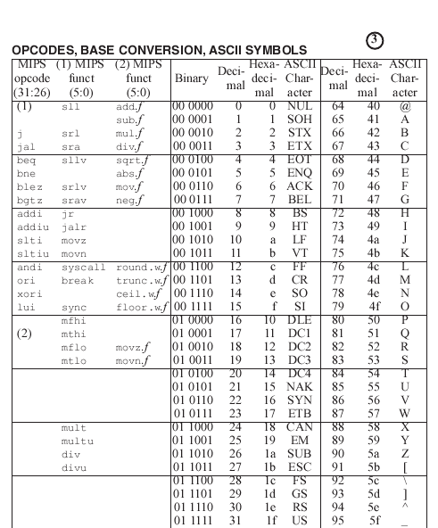
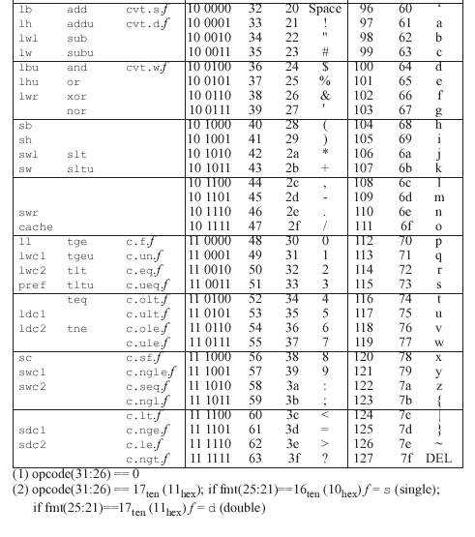
MIPS Op-codes and Funct-codes
See “Green Sheet” in the textbook

Slide 48
Hexadecimal
Base 16
Compact representation of bit strings
4 bits per hex digit
0 | 0000 | 4 | 0100 | 8 | 1000 | c | 1100
1 | 0001 | 5 | 0101 | 9 | 1001 | d | 1101
2 | 0010 | 6 | 0110 | a | 1010 | e | 1110
3 | 0011 | 7 | 0111 | b | 1011 | f | 1111
Example: eca8 6420
1110 1100 1010 1000 0110 0100 0010 0000

Slide 49
Shift Instructions
op
rs
rt
rd
shamt
funct
6 bits
5 bits
5 bits
5 bits
5 bits
6 bits
shamt: how many positions to shift
rs: not used (always 0)
Shift left logical (sll)
Shift to the left. fill zero bits on the right
sll rd,rt,i # rt shifted left i positions
Shift i positions effectively multiplies by 2^{i}
Shift right logical (srl)
Shift to the right, fill zero bits on the left
srl rd,rt,i # rt shifted right i positions
Shift i positions effectively divides by 2^{i} (unsigned only)
Shift right arithmetic (sra)
Shift to the right, replicate sign bit on the left
sra rd,rt,i # rt shifted right arithm. i positions
Shift i positions effectively divides by 2^{i}

Slide 50
Logic Shifting
Shift Left: sll $s1,$s2,2 #s1=s2<<2
Store in $s1 the value from $s2 shifted 2 bits to the left (they fall off end), inserting 0’s on right; << in C.
Before: 0000 0002_{hex} 0000 0000 0000 0000 0000 0000 0000 0010_{two}
After: 0000 0008_{hex} 0000 0000 0000 0000 0000 0000 0000 1000_{two}
What arithmetic effect does shift left have?
Shift Right: srl is opposite shift; >>

Slide 51
Arithmetic Shifting
Shift right arithmetic moves n bits to the right (insert high order sign bit into empty bits)
For example, if register $s0 contained
1111 1111 1111 1111 1111 1111 1110 0111_{two}= -25_{ten}
If executed sra $s0, $s0, 4, result is:
1111 1111 1111 1111 1111 1111 1111 1110_{two}= -2_{ten}
Unfortunately, this is NOT same as dividing by 2^{n}
Fails for odd negative numbers
C arithmetic semantics is that division should round towards 0
Notes:
\

Slide 52
I-Format Instructions (1/4)
What about instructions with immediates?
5-bit field only represents numbers up to the value 31: immediates may be much larger than this
Ideally, MIPS would have only one instruction format (for simplicity): unfortunately, we need to compromise
Define new instruction format that is partially consistent with R-format:
First notice that, if instruction has immediate, then it uses at most 2 registers.

Slide 53
I-Format Instructions (2/4)
Define “fields” of the following number of bits each: 6 + 5 + 5 + 16 = 32 bits
Again, each field has a name:
Key Concept: Only one field is inconsistent with R-format. Most importantly, opcode is still in same location.
6
5
5
16
opcode
rs
rt
immediate

Slide 54
I-Format Instructions (3/4)
What do these fields mean?
opcode: same as before except that, since there’s no funct field, opcode uniquely specifies an instruction in I-format
This also answers question of why R-format has two 6-bit fields to identify instruction instead of a single 12-bit field: in order to be consistent as possible with other formats while leaving as much space as possible for immediate field.
rs: specifies a register operand (if there is one)
rt: specifies register which will receive result of computation (this is why it’s called the target register “rt”) or other operand for some instructions.

Slide 55
I-Format Instructions (4/4)
The Immediate Field:
addi the immediate is sign-extended to 32 bits. Thus, it’s treated as a signed integer.
16 bits ➔ can be used to represent immediate up to 2¹⁶ different values
This is large enough to handle the offset in a typical lw or sw.
Later, we’ll see what to do when a value is too big for 16 bits
lw $t0, 32($s3)
sw $t0, 48($s3)

Slide 56
I-Format Example (1/2)
MIPS Instruction:
addi $21,$22,-50
opcode = 8 (look up in table in book)
rs = 22 (register containing operand)
rt = 21 (target register)
immediate = -50 (by default, this is decimal in assembly code)

Slide 57
I-Format Example (2/2)
MIPS Instruction:
addi $21,$22,-50
Decimal/field representation:
8
22
21
-50
Binary/field representation:
001000
10110
10101
1111111111001110
hexadecimal representation: 22D5 FFCE_{hex}
decimal representation: 584,449,998_{ten}

Slide 58
Logical Operations
Make bitwise changes
Useful for handling selected bits/fields
extract, insert, mask, flip
Logical instructions have format R or I
In format I, the immediate value is always unsigned
Operation | C/C++ | Java | MIPS
Shift left | << | << | sll
Shift right logical | >> (for unsigned type) | >>> | srl
Shift right arithmetic | >> (for signed type) | >> | sra
Bitwise AND | & | & | and,andi
Bitwise OR | | | | | or,ori
Bitwise NOR | n/a | n/a | nor
Bitwise XOR | ^ | ^ | xor,xori
Bitwise NOT | ~ | ~ | (uses nor)

Slide 59
Logical Operations
Instructions for bitwise manipulation
Operation | C | Java | MIPS
Shift left | << | << | sll
Shift right | >> | >>> | srl
Bitwise AND | & | & | and, andi
Bitwise OR | | | | | or, ori
Bitwise NOT | ~ | ~ | nor
Useful for extracting and inserting groups of bits in a word

Slide 60
AND Operations
Useful to mask bits in a word
Select some bits, clear others to 0
and $t0, $t1, $t2
$t2
0000 0000 0000 0000 0000 1101 1100 0000
$t1
0000 0000 0000 0000 0011 1100 0000 0000
$t0
0000 0000 0000 0000 0000 1100 0000 0000

Slide 61
OR Operations
Useful to include bits in a word
Set some bits to 1, leave others unchanged
or $t0, $t1, $t2
$t2
0000 0000 0000 0000 0000 1101 1100 0000
$t1
0000 0000 0000 0000 0011 1100 0000 0000
$t0
0000 0000 0000 0000 0011 1101 1100 0000

Slide 62
Bitwise NOT
Useful to invert bits in a word
Change 0 to 1, and 1 to 0
MIPS does not have a NOT opcode
Use NOR instead
rd=NOT(rs) is equivalent to rd=NOR(rs,$0)
nor rd,rs,$0
rs
0001 0000 0000 0000 0011 1100 0000 0010
$0
0000 0000 0000 0000 0000 0000 0000 0000
nor(rs,$0)
1110 1111 1111 1111 1100 0011 1111 1101

